Slide 1

Lead Scoring Case Study
BY :- Varad Anand

Slide 2

Background
X Education , An education company named sells online courses to industry professionals.
Many interested professionals land on their website.
Once these leads are acquired, employees from the sales team start making calls, writing emails, etc. Through this process, some of the leads get converted while most do not.
When these people fill up a form providing their email address or phone number, they are classified to be a lead.

Slide 3


Lead – Conversion Process
Lead Generation:
1. Ads on websites like Google
2. Referrals
Visit to X Education website by these potential customers (professionals)

Slide 4

Visitors either provide Email id & Contact Details Or View videos etc. Tele calling and Emailing activity to all the leads.

Slide 5
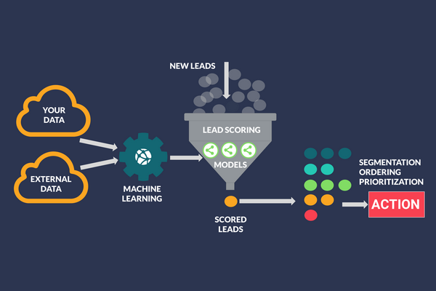
Problem Statement
An education company named X Education sells online courses to industry professionals. On any given day, many professionals who are interested in the courses land on their website and browse for courses.
The company markets its courses on several websites and search engines like Google. Once these people land on the website, they might browse the courses or fill up a form for the course or watch some videos. When these people fill up a form providing their email address or phone number, they are classified to be a lead. Moreover, the company also gets leads through past referrals. Once these leads are acquired, employees from the sales team start making calls, writing emails, etc. Through this process, some of the leads get converted while most do not. The typical lead conversion rate at X education is around 30%.

Slide 6
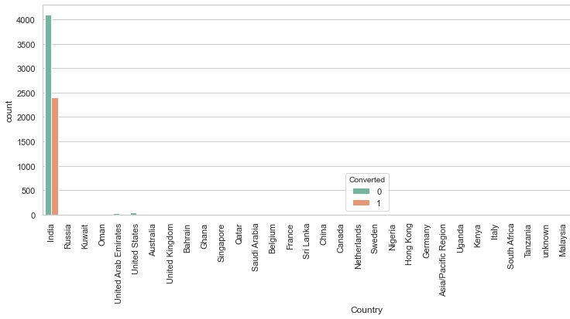
EDA Plots - Categorical Attributes Analysis. Plotting spreads of country column.

Slide 7
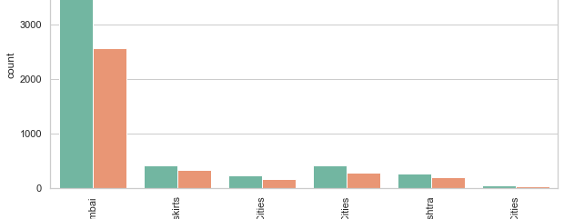
EDA Plots - Plotting Spread of city column after replacing NaN value.

Slide 8
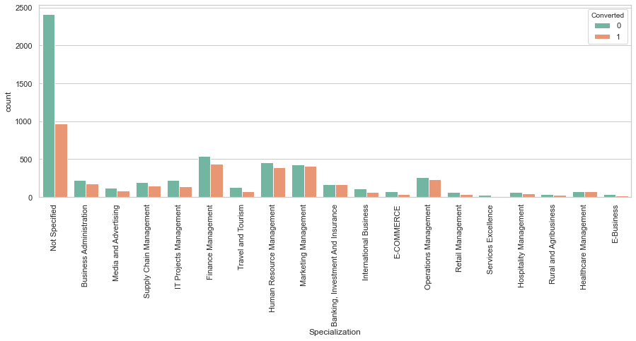
Lead may not have mentioned specialization because it was not in the list or maybe they are a students. We do not have a specialization yet. So we will replace NaN values here with 'Not Specified’. We see that specialization with Management in them have higher number of leads as well as leads converted. Definitely a significant variable and should not be dropped.

Slide 9
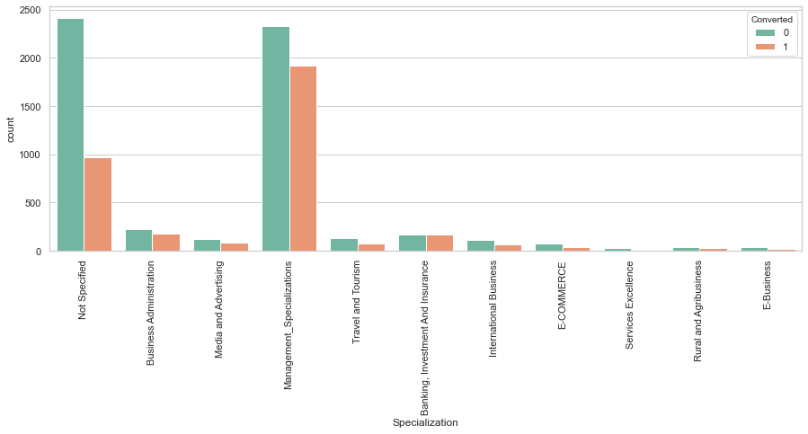
Graph-Visualizing count of Variable based on Converted value. Combining Management Specializations because they show similar trends.

Slide 10
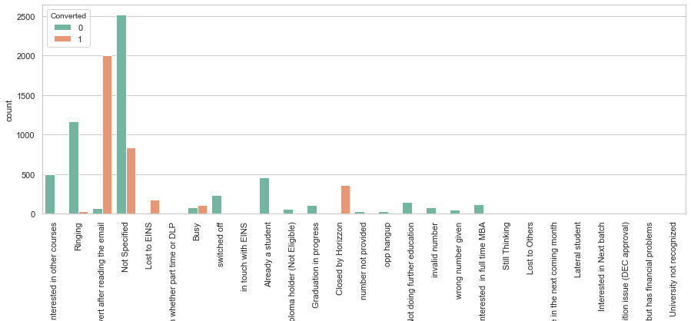
EDA Plots - Visualizing count of Variable based on Converted value Working Professionals going for the course have high chances of joining it. Unemployed leads are the most in terms of Absolute numbers.

Slide 11
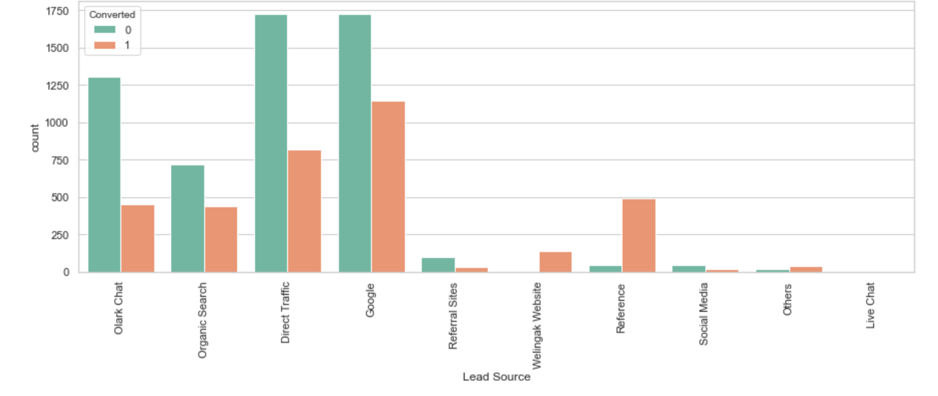
INFERENCE Maximum number of leads are generated by Google and Direct traffic. Conversion Rate of reference leads and leads through welingak website is high. To improve overall lead conversion rate, focus should be on improving lead converion of olark chat, organic search, direct traffic, and google leads and generate more leads from reference and welingak website.

Slide 12
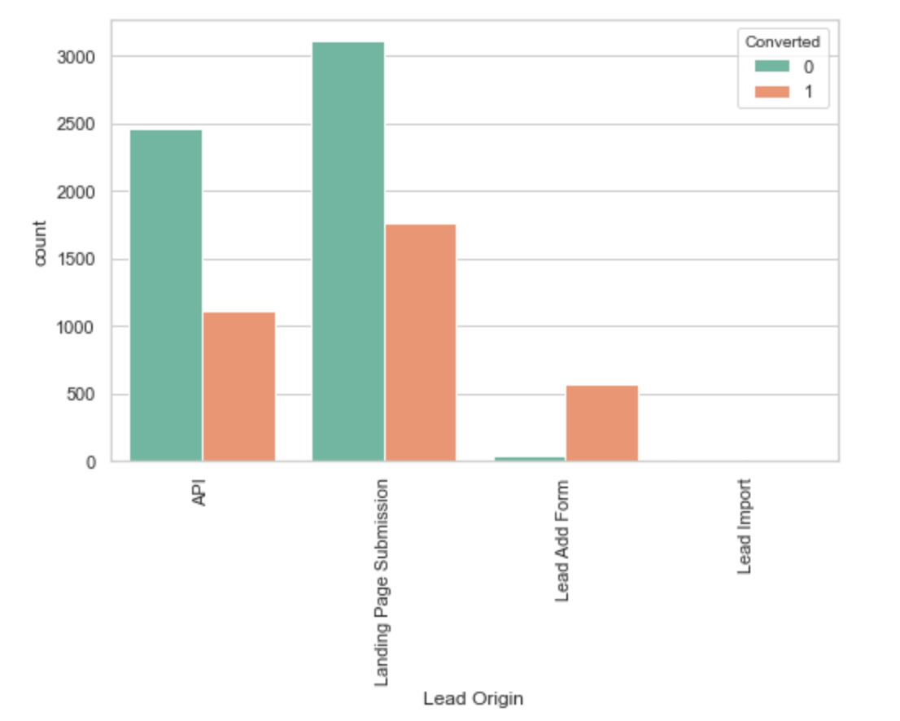
Inference API and Landing Page Submission bring higher number of leads as well as conversion. Lead Add Form has a very high conversion rate but count of leads are not very high. Lead Import and Quick Add Form get very few leads. In order to improve overall lead conversion rate, we must improve lead conversion of API and Landing Page Submission origin and generate more leads from Lead Add Form.

Slide 13
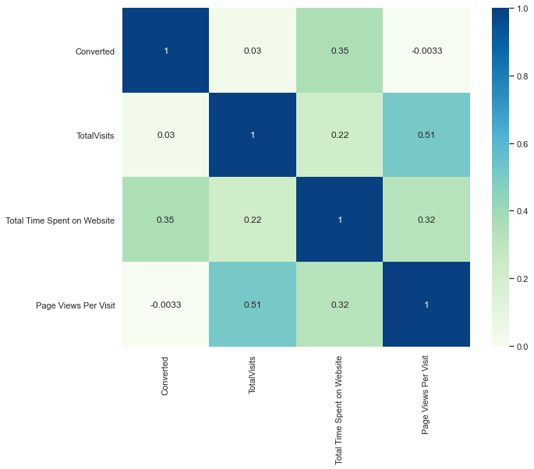
Numerical Attributes Analysis: Check the % of Data that has Converted Values. Checking correlations of numeric values.

Slide 14
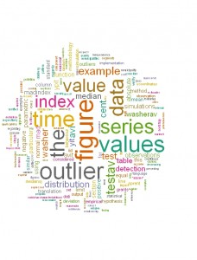
Outliers

Slide 15
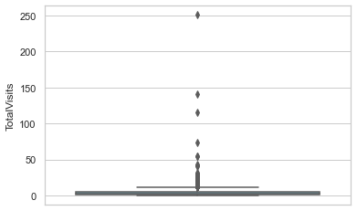
- We can see presence of outliers here. - Visualizing spread of variable.

Slide 16
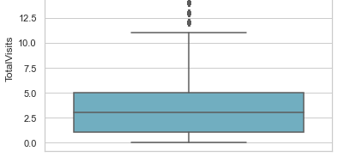
Graph Showing-Outlier Treatment: Remove top & bottom 1% of the Column Outlier values. Checking percentiles for "Total Time Spent on Website”.

Slide 17
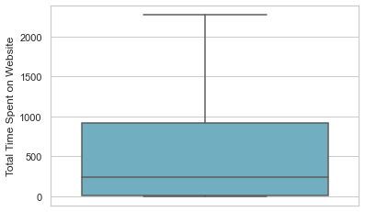
Since there are no major Outliers for the above variable. Any Outlier Treatment for this above Column. Visualizing spread of numeric variable.

Slide 18
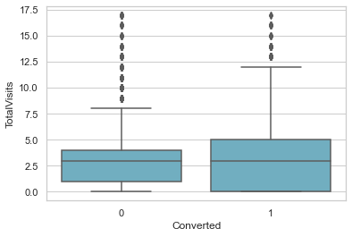
Median for converted and not converted leads are close. No conclusive can be said based on Total Visits.

Slide 19
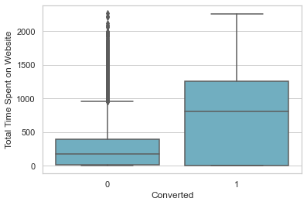
Median for converted and unconverted leads is the same. From page view per visit we cannot specify lead conversion.

Slide 20
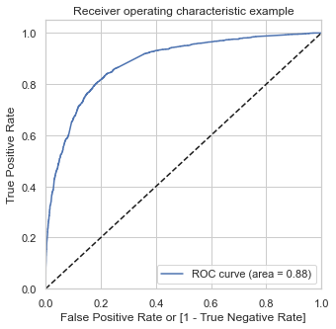
PLOTTING ROC CURVE: The ROC Curve should be a value close to 1. In good prediction module, a good value of 0.88 indicated.

Slide 21

Dummy variable Creation
Scaling of Data : Train-Test Split & Logistic Regression Model Building. Model Building using Stats Model & RFE. P-value of variable What is your current occupation Housewife Sites is high, so we can drop it. p-value of variable Specialization Rural and Agribusiness Sites is high, so we can drop it. There is no high correlation higher value VIF or P value in this model
So the Values all seem to be in order so now, Moving on to derive the Probabilities, Lead Score, Predictions on Train Data:

Slide 22

Final Observation: Let us compare the values obtained for Train & Test: Train Data: - Accuracy : 80.74% - Sensitivity : 80.91% - Specificity : 80.63%Test Data: - Accuracy : 79.48% - Sensitivity : 78.38% - Specificity : 80.16%

Slide 23

Test set Final Observation: After running the model on the Test Data these are the figures we obtain: Accuracy : 79.48% Sensitivity : 78.38% Specificity : 80.16%.

Slide 24

Some Interesting Facts

Slide 25


Slide 26


Slide 27

Thank You

